Slide 1


Team 25
Francesco Paterna
Andrea Restelli
Andrea Sanchini
Specifica #4 – Verbalizzazione degli esami

Slide 2
Additional Features

Slide 3
Pure HTML Version

Slide 4
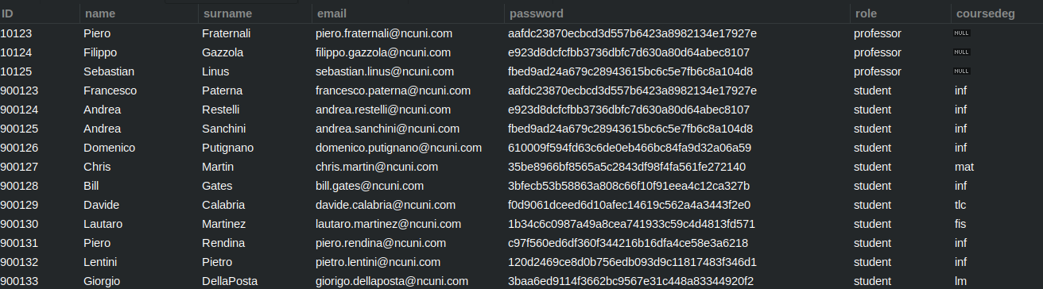
Secure Password Storage
We don’t store the password in clear text inside the Database
We made the CheckLogin servlet capable of generating password digests using hash functions.
[For this demo we chose SHA1]

Slide 5

Advanced User Experience
All buttons change color according to their availability.
The table has dynamic labels that indicate the order to the user

Slide 6
Advanced User Experience
All buttons change color according to their availability.
The table has dynamic labels that indicate the order to the user

Slide 7
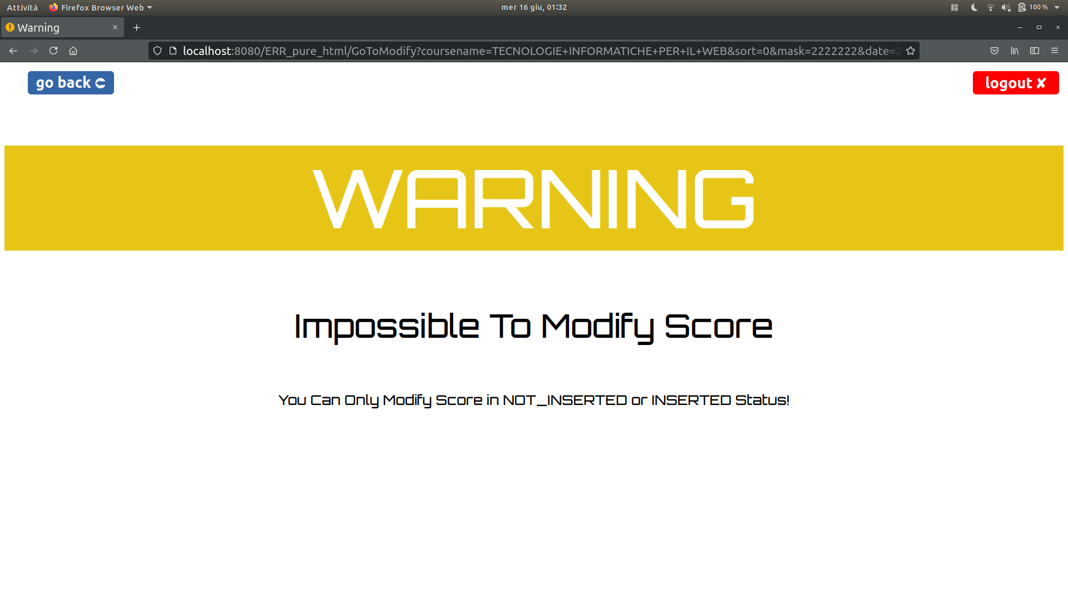
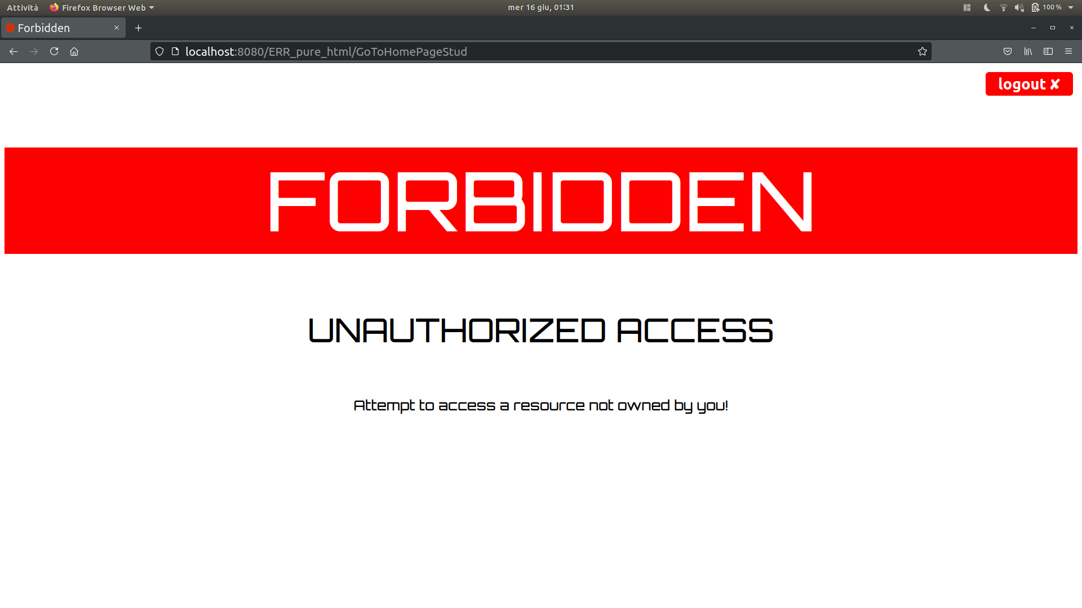
Customized Error Pages
Two level of security breach
Warning Page: Indicates a medium security breach, allow the user to go back
Forbidden Page:
Indicates a serious security breach causing session invalidation

Slide 8
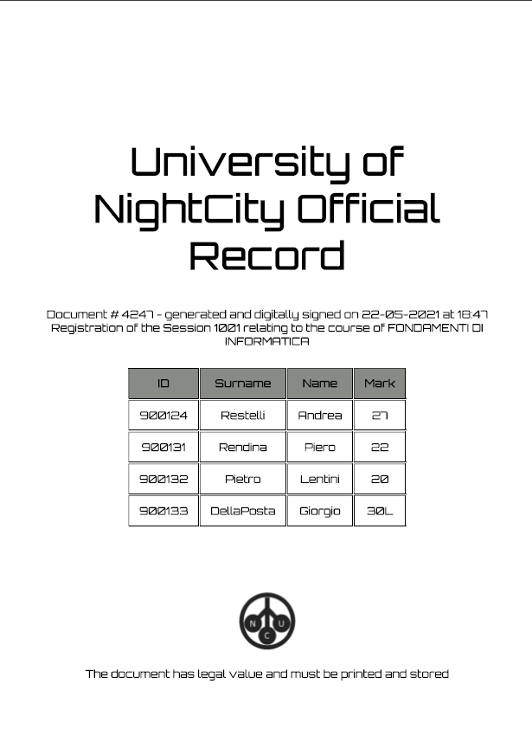
PDF Generator
In the Record Page, the professor will find a button to generate and print the Record in PDF.

Slide 9
Javascript Version

Slide 10
Secure Password Storage
We don’t store the password in clear text inside the Database
We made the CheckLogin servlet capable of generating password digests using hash functions.
[For this demo we chose SHA1]

Slide 11

Advanced User Experience
All buttons change color according to their availability.
The Session Enrolls table has dynamic labels that indicate the order to the user
A lot of function, only one page, thanks to waiter function
Modal Windows allow a comfortable view for seeing record or use the multiple modify

Slide 12
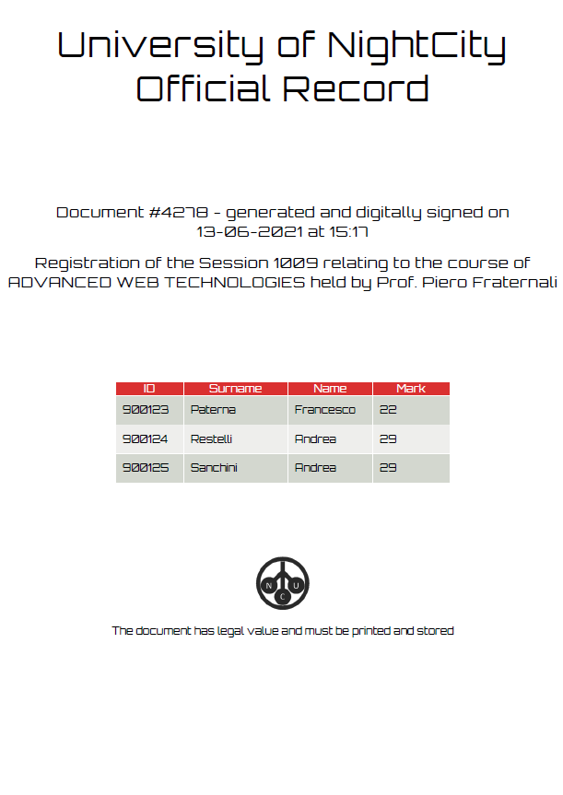
PDF Generator
In the Record Page, the professor will find a button to generate and print the Record in PDF.

